Slide 1

Current cluster by environment of the branch of After You Desert Cafe
Where they are… by the location

Slide 2
Background

Slide 3
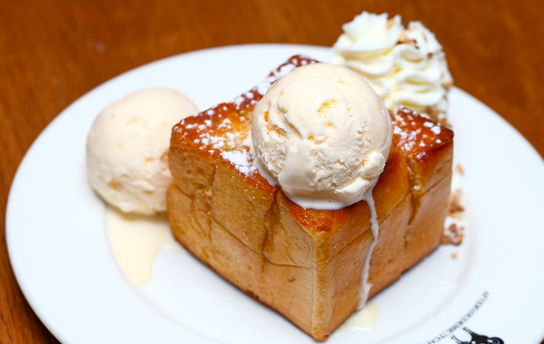

After You Desert Café is very famous in Thailand. There are many desert which is high sales in each year.
You can find more detail on https://www.afteryoudessertcafe.com/en/

Slide 4
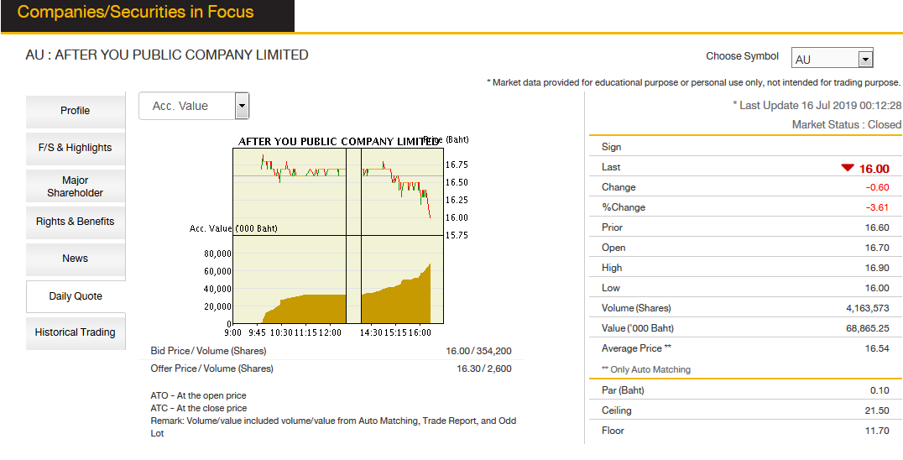
The company is listed in stock exchange in Thailand. You can find more information in
https://www.set.or.th/set/mainpage.do?language=en&country=US

Slide 5
THE ISSUE!!!
So the company has to open new branch to expand more accessibility but have to ensure the location is suitable
One big lesson learn is the new branch in ‘airport’ was opened but do not perform well and have to be closed one year later.

Slide 6
The ASSUMTION and question
Location may be the issue. If we know the current situation of current branches (n = 74) and cluster them into group, it may be some clues about growth to be predict.
I would like to know if there is any different between all branches of After You in Thailand by nearby location?

Slide 7
Methodology

Slide 8
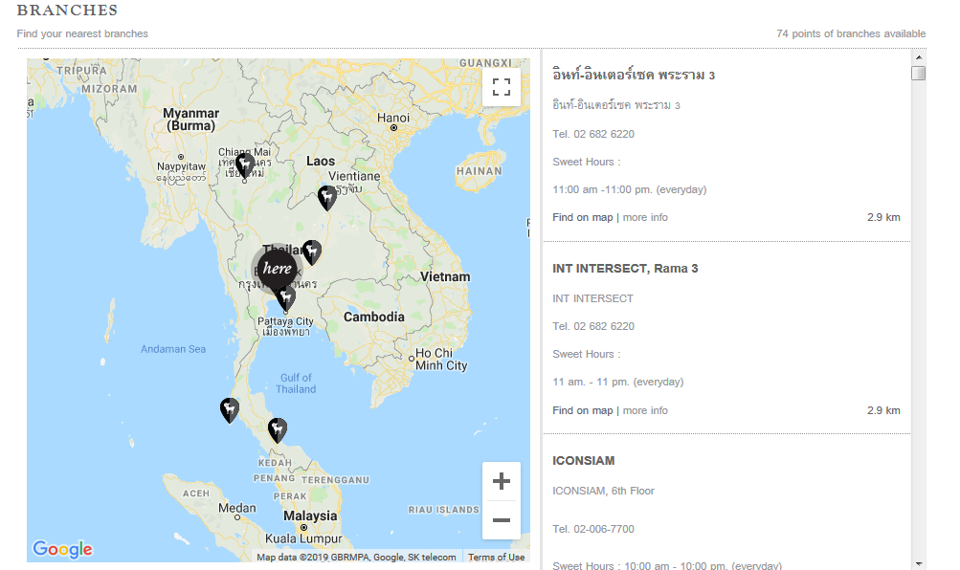
The 74 branches
We will find out all of the branches in the website.
https://www.afteryoudessertcafe.com/en/branches/

Slide 9
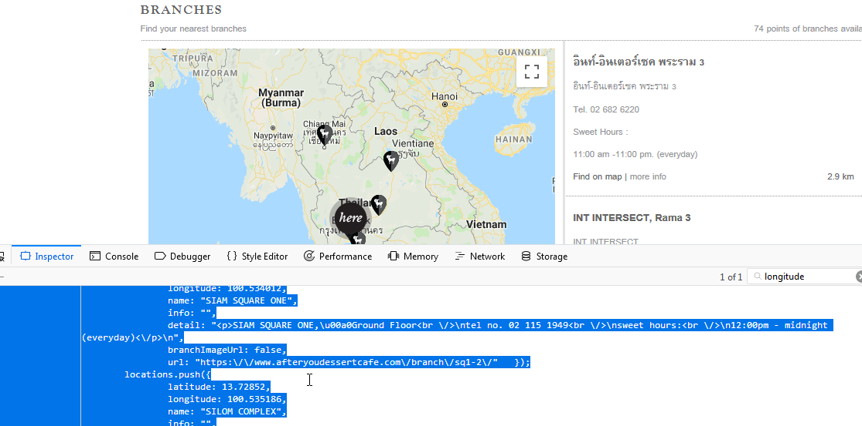
Clues is here

Slide 10
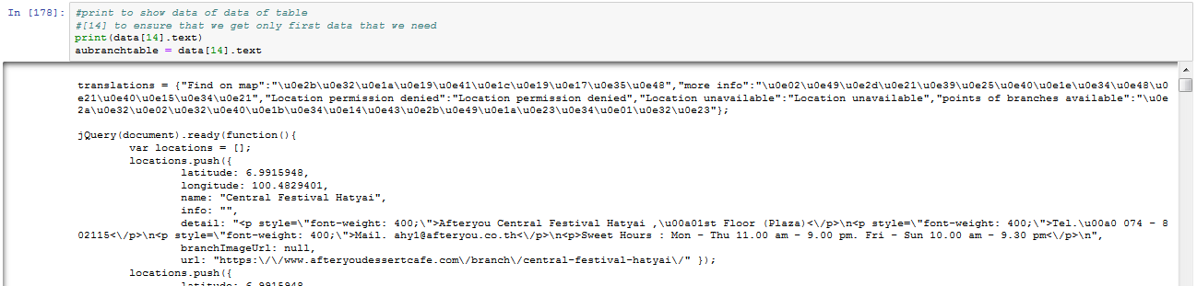
Starting to scrape
Beautifulsoup is used to get data of
Branch name
(Please note that some branches are in Thai and will be unicode)
Location
Latitude
longitude

Slide 11
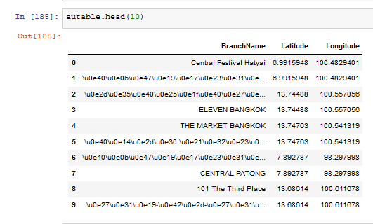
Name and location are tracked
Using regular expression and panda, the table of all branches are tracked

Slide 12
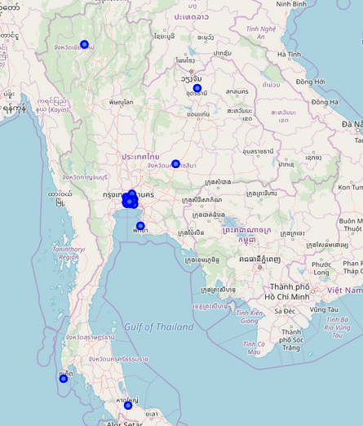
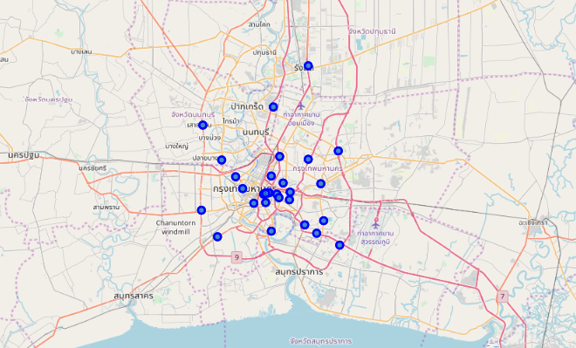
Using Folium to get map point
Most of the Branches are in Bangkok
Bangkok
Thailand

Slide 13
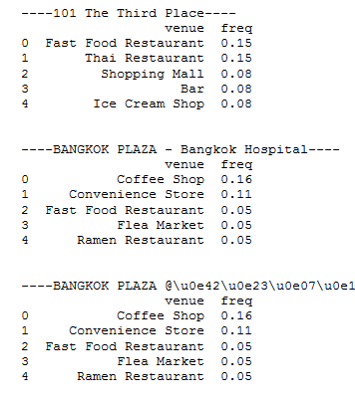
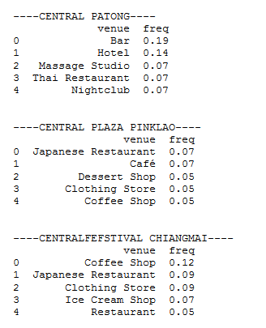
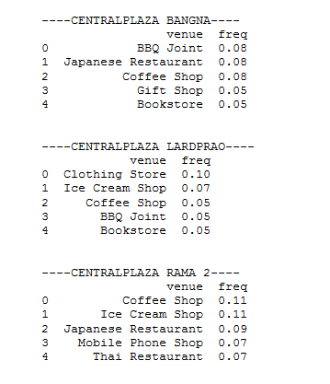
Foursqure time!
Using Foursqure to track nearby palce in 200 meter. Here is some example:

Slide 14
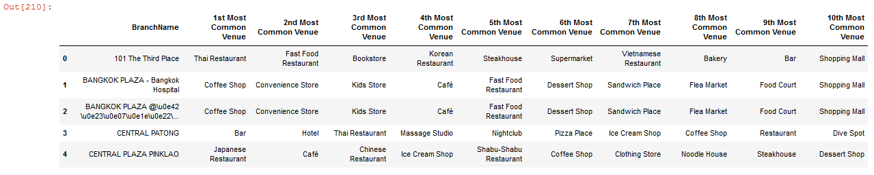
Adjust data in Table
Show each data with most common value

Slide 15
Main result

Slide 16
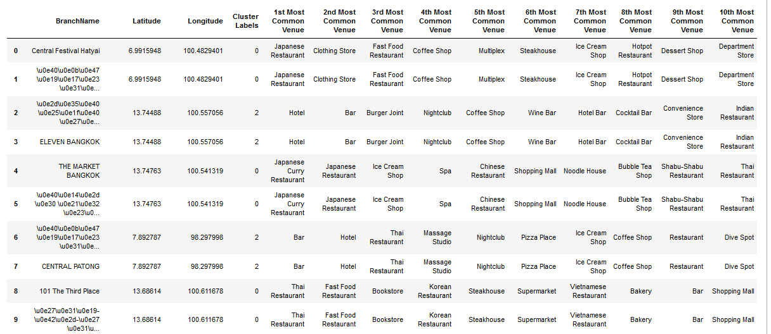
Analyze by adding cluster

Slide 17
4 Cluster assumption
Cluster0: Nearby Restaurant
Cluster1: Nearby Cafe
Cluster2: Nearby Hotel/Bar/Spa
Cluster3: Nearby Shopping center

Slide 18
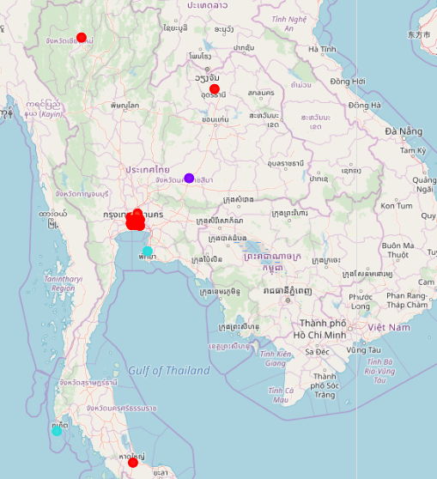
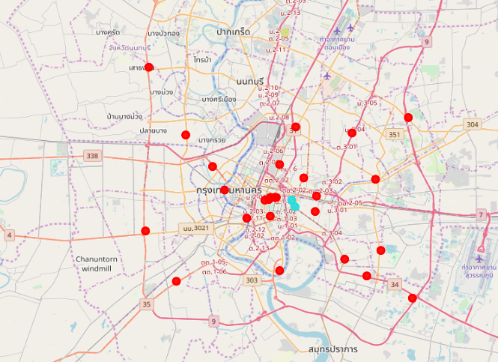
Folium Plot
It can be noticed that the branch in Phuket (Nearby Hotel) and Nakhon Ratchasima (Nearby Café) (non-Bangkok is different cluster.
In Bangkok, most of them are the same cluster
Only 3 branches are different:
The Portal Mueng Thong (Nearby Shopping Center)
Eleven bangkok (Nearby Hotel)
Terminal 21 (Nearby Hotel)
Thailand
Bangkok

Slide 19
Discussion & Conclusion

Slide 20
From the different between branch in Bangkok and other provinces are cluster. This may be because of Bangkok are main economy city with containing numbers of restaurant.
It should be focus on performance of different cluster (Phuket and Nakhon Ratchasima) if it perform well or not?
If it perform well, it is possible to open new branch which have nearby area like these province
It should be focus on performance of different cluster in Bangkok (The Portal Mueng Thong, Eleven bangkok, Terminal 21 - Nearby Hotel and shopping center).
It should be compared with other branches (nearby restaurant). Which cluster perform better?

Slide 21
Conclusions
Most of the branches of After You will open nearby restaurant.
For non-Bangkok, it also mainly nearby restaurant but some is nearby restaurant and café
It should be explored more information compare between the branches nearby restaurant and other types in term of sales. However, the data is limited. It should be proposed to After You Company.

